Slide 1


Grid container properties

Slide 2

Topics
Introduction
Grid container properties

Slide 3
Introduction
A grid container is an HTML element that defines a grid layout. To control the layout of the grid items within the container, various CSS properties can be applied to the container itself.

Slide 4
Now we will understand different grid container properties
Below is sample HTML we will use in later slides,
<div class="container">
<div>1</div>
<div>2</div>
<div>3</div>
<div>4</div>
<div>5</div>
<div>6</div>
</div>

Slide 5
Grid container properties
display
display property is set to "grid" to define the container as a grid container.
.container {
display: grid;
}

Slide 6
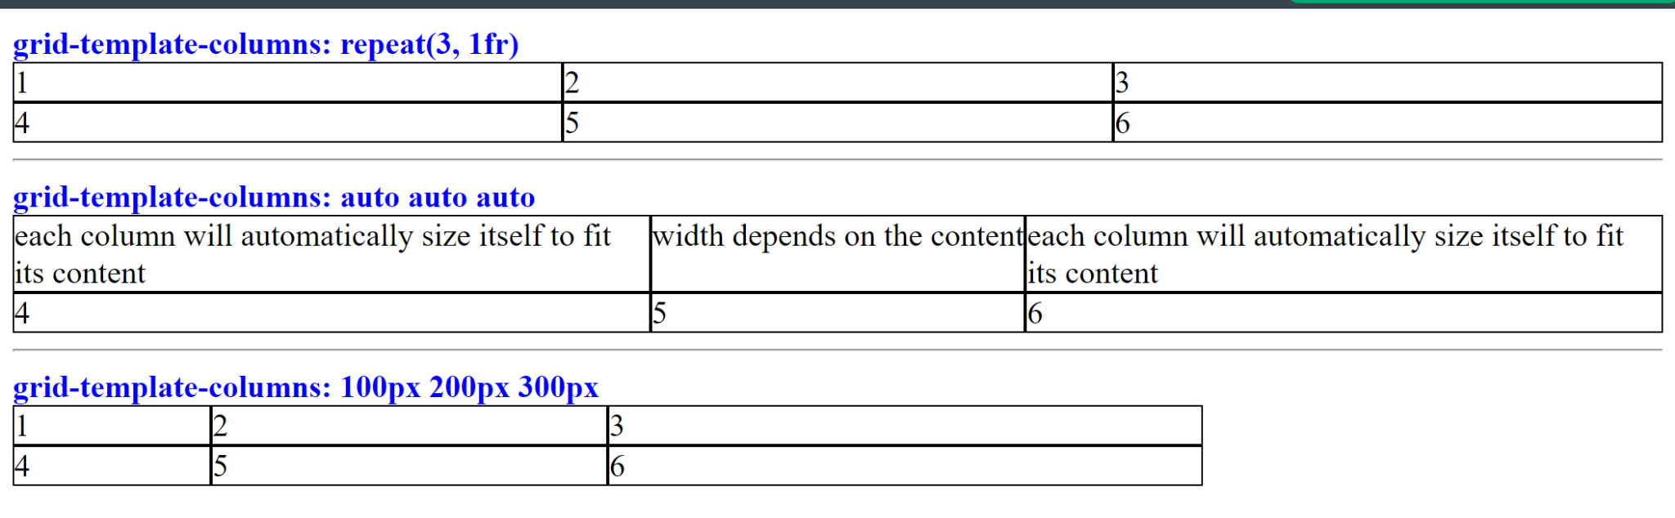
grid-template-columns:
grid-template-columns property specifies the number and size of columns in the grid. You can use values like pixels, percentages, or fractions to define the column widths.
.container {
display: grid;
grid-template-columns: repeat(3, 1fr);
}
.container {
display: grid;
grid-template-columns: repeat(3, 1fr);
}
.container {
display: grid;
grid-template-columns: repeat(3, 1fr);
}

Slide 7
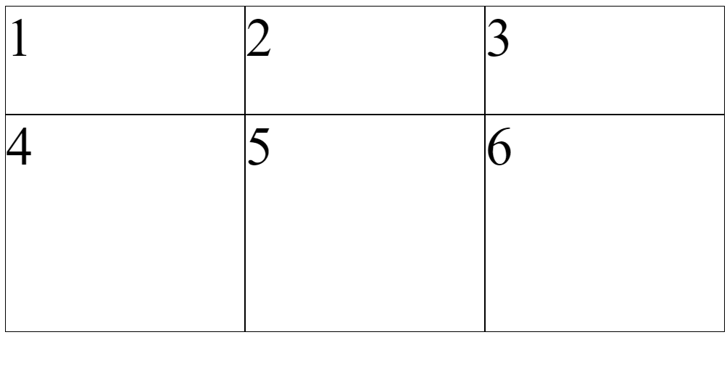
grid-template-rows
grid-template-rows property specifies the number and size of rows in the grid. You can use values like pixels, percentages, or fractions to define the row heights.
.container {
display: grid;
grid-template-rows: 100px 200px;
grid-template-columns: repeat(3, 1fr);
}

Slide 8
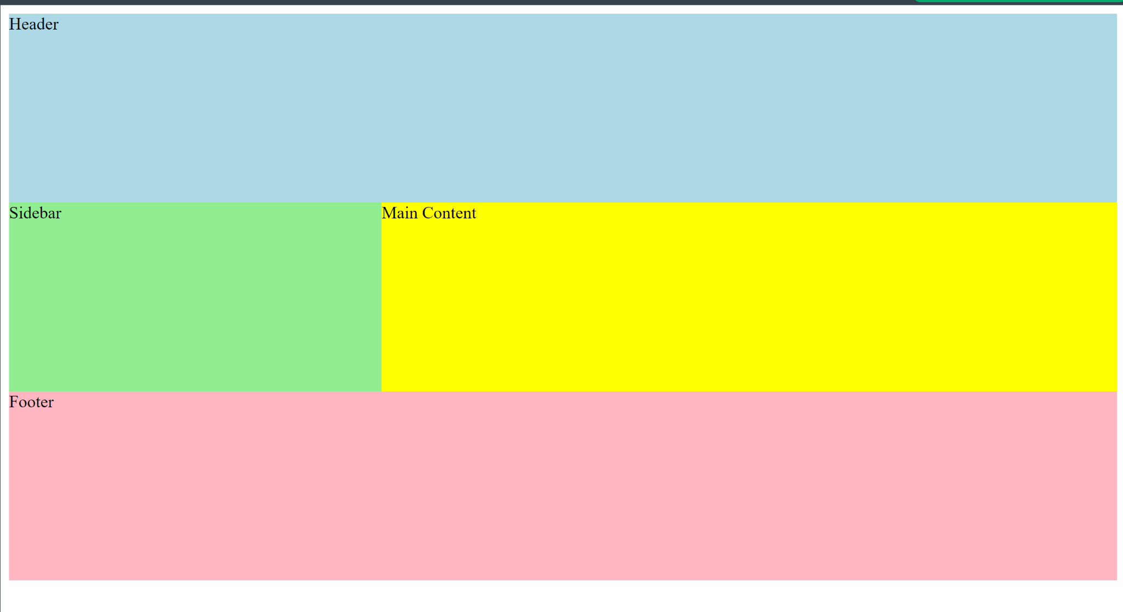
grid-template-areas
grid-template-areas property defines named grid areas within the grid container. Each area can be assigned a name and then referenced in the CSS rules for the grid items.
.grid-container {
display: grid;
grid-template-areas:
"header header header "
"sidebar main main"
"footer footer footer";
height: 90vh;
}
.header {
grid-area: header;
background-color: lightblue;
}
.sidebar {
grid-area: sidebar;
background-color: lightgreen;
}
.main {
grid-area: main;
background-color: yellow;
}
.footer {
grid-area: footer;
background-color: lightpink;
}

Slide 9
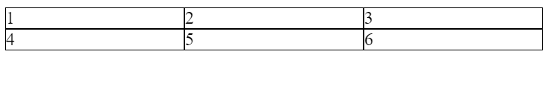
grid-template
grid-template is a shorthand property that combines grid-template-rows and grid-template-columns into a single property. It allows you to specify both the rows and columns of the grid in a single line.
.container {
display: grid;
grid-template:
repeat(2, 1fr)
/ repeat(3, 1fr);
}

Slide 10
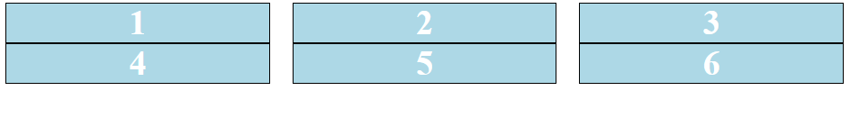
grid-column-gap
grid-column-gap is a CSS property that defines the size of the gap or space between the columns of a grid. It is used to create space between the columns and make the grid more visually appealing.
.grid-container {
display: grid;
grid-template-columns: auto auto auto;
grid-column-gap: 20px;
}

Slide 11
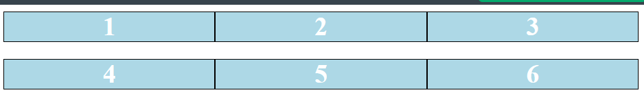
grid-row-gap
grid-row-gap is a CSS property that defines the size of the gap or space between the rows of a grid. It is used to create space between the rows and make the grid more visually appealing.
.grid-container {
display: grid;
grid-template-columns: auto auto auto;
grid-row-gap: 20px;
}

Slide 12
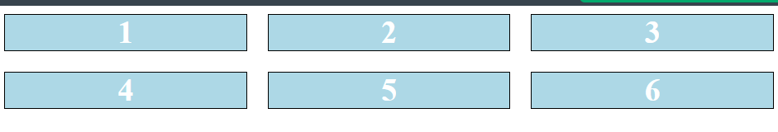
grid-gap
grid-gap property sets the size of the gap between grid items, both horizontally and vertically. It’s a shorthand property for grid-column-gap and grid-row-gap properties.
.container {
display: grid;
grid-template:
repeat(2, 1fr) / repeat(3, 1fr);
grid-gap:20px;
}

Slide 13
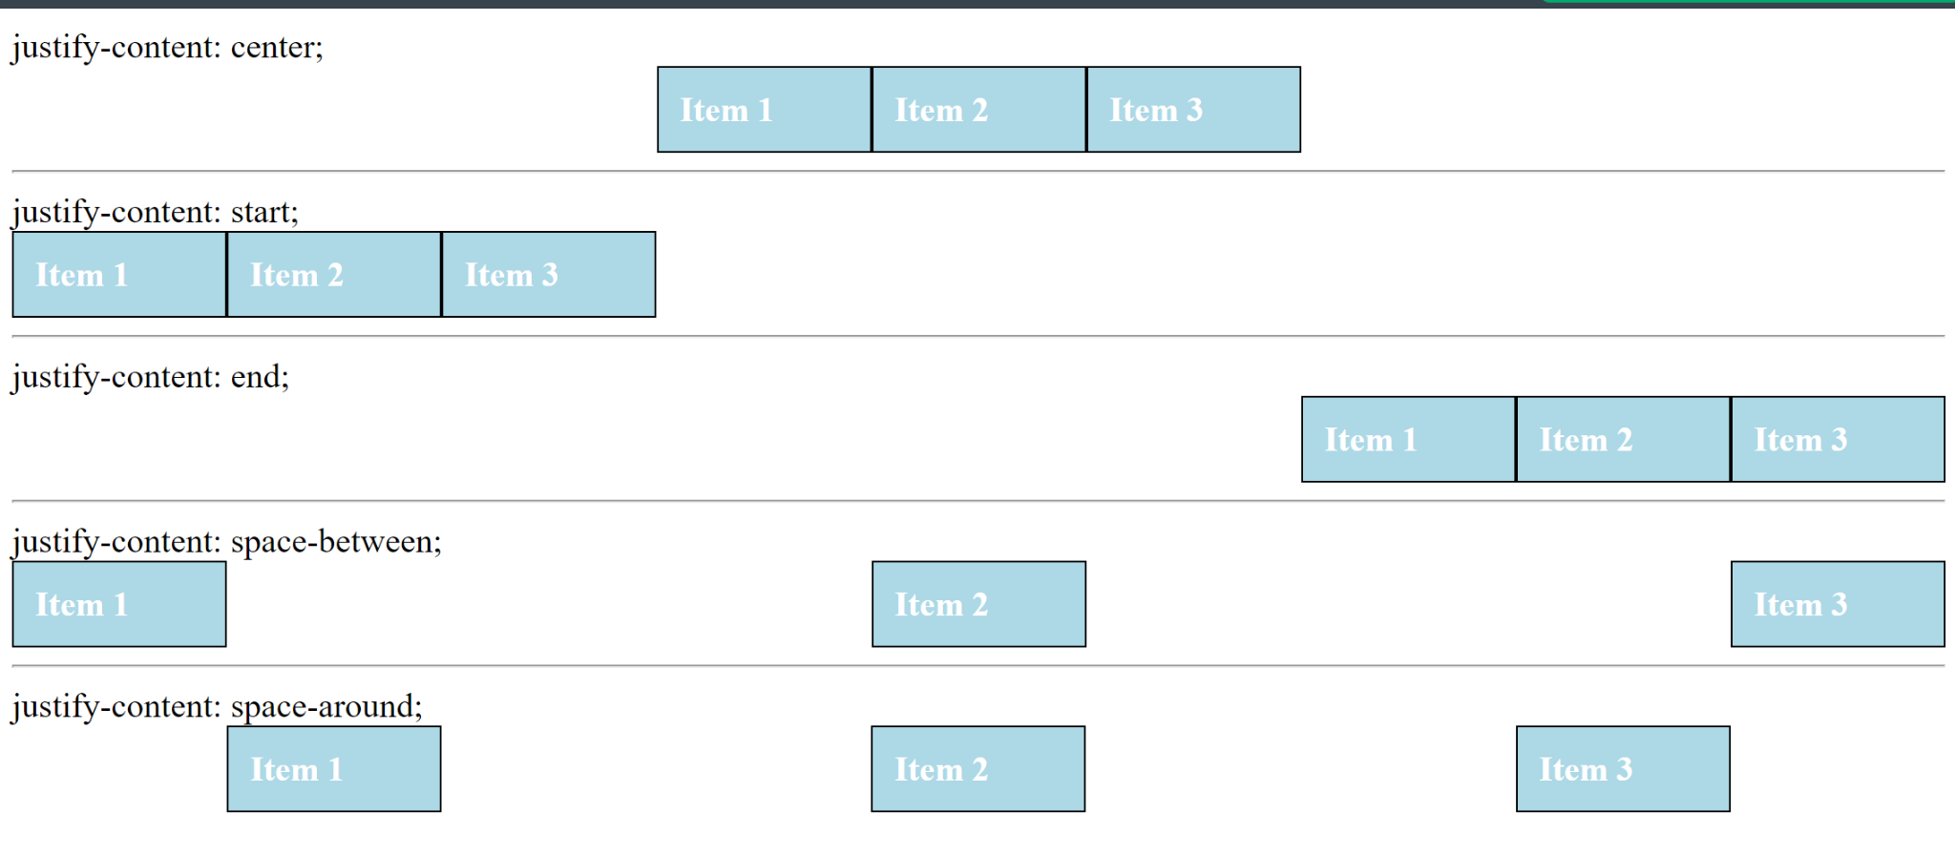
justify-content
The justify-content property in CSS Grid is used to horizontally align grid items within a grid container. It controls how the grid tracks (the columns or rows) are aligned along the horizontal axis of the grid container.
.container1 {
display: grid;
grid-template-columns: repeat(3, 100px);
justify-content: center;
background-color: light-blue;
}
.container2 {
display: grid;
grid-template-columns: repeat(3, 100px);
justify-content: start;
background-color: light-blue;
}
.container3 {
display: grid;
grid-template-columns: repeat(3, 100px);
justify-content: end;
background-color: light-blue;
}
.container4 {
display: grid;
grid-template-columns: repeat(3, 100px);
justify-content: space-between;
background-color: light-blue;
}
.container5 {
display: grid;
grid-template-columns: repeat(3, 100px);
justify-content: space-around;
background-color: light-blue;
}

Slide 14
align-content
align-content is a CSS property used to set how the browser distributes the space between rows in a grid container, when there is extra space available. It only applies when there is extra space in the cross-axis.
.container1 {
display: grid;
grid-template-columns: repeat(3, 1fr);
grid-template-rows: repeat(2, 30px);
grid-row-gap: 10px;
align-content: flex-start;
height: 120px;
border: 1px solid red;
}
.container2 {
display: grid;
grid-template-columns: repeat(3, 1fr);
grid-template-rows: repeat(2, 30px);
grid-row-gap: 10px;
align-content: flex-end;
height: 120px;
border: 1px solid red;
}
.container3 {
display: grid;
grid-template-columns: repeat(3, 1fr);
grid-template-rows: repeat(2, 30px);
grid-row-gap: 10px;
align-content: center;
height: 120px;
border: 1px solid red;
}
.container4 {
display: grid;
grid-template-columns: repeat(3, 1fr);
grid-template-rows: repeat(2, 30px);
grid-row-gap: 10px;
align-content: space-between;
height: 120px;
border: 1px solid red;
}
.container5 {
display: grid;
grid-template-columns: repeat(3, 1fr);
grid-template-rows: repeat(2, 30px);
grid-row-gap: 10px;
align-content: space-around;
height: 120px;
border: 1px solid red;
}
.container6 {
display: grid;
grid-template-columns: repeat(3, 1fr);
grid-template-rows: repeat(2, 30px);
grid-row-gap: 10px;
align-content: stretch;
height: 120px;
border: 1px solid red;
}

Slide 15
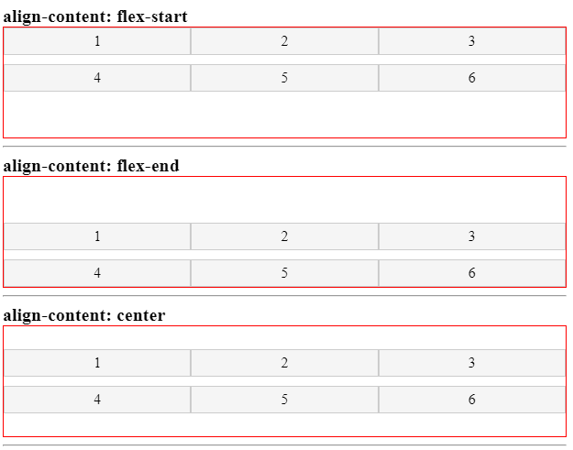
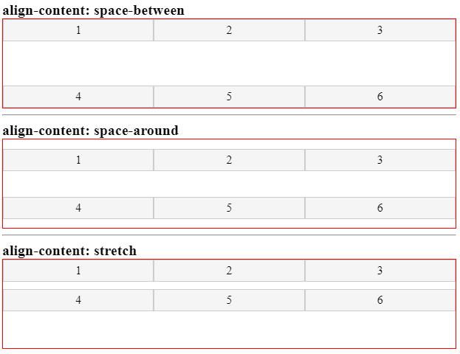
align-content

Slide 16
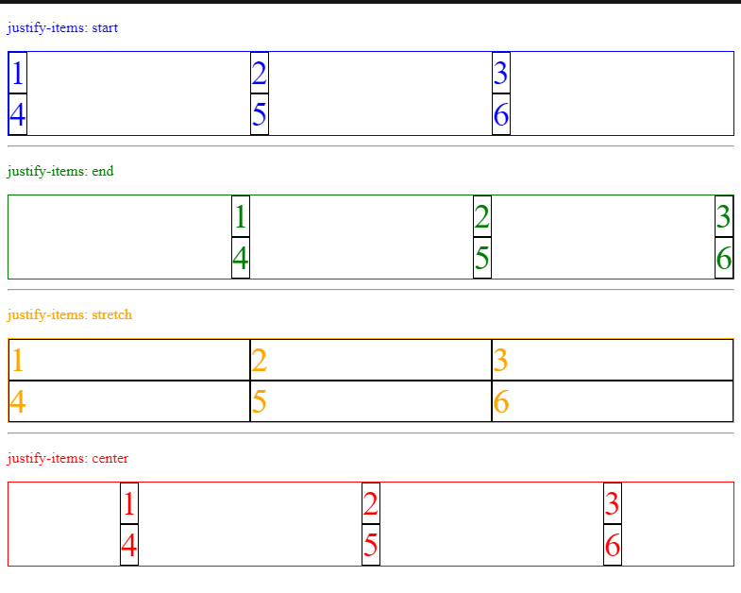
justify-items
justify-items property aligns grid items horizontally within their grid cell. The values are start , end , center , and stretch
.container1 {
display: grid;
grid-template-columns: repeat(3, 1fr);
justify-items: start;
font-size: 36px;
margin-bottom: 10px;
border: 1px solid blue;
color: blue;
}
.container2 {
display: grid;
grid-template-columns: repeat(3, 1fr);
justify-items: end;
font-size: 36px;
margin-bottom: 10px;
border: 1px solid blue;
color: blue;
}
.container1 {
display: grid;
grid-template-columns: repeat(3, 1fr);
justify-items: stretch;
font-size: 36px;
margin-bottom: 10px;
border: 1px solid blue;
color: blue;
}
.container1 {
display: grid;
grid-template-columns: repeat(3, 1fr);
justify-items: center;
font-size: 36px;
margin-bottom: 10px;
border: 1px solid blue;
color: blue;
}

Slide 17
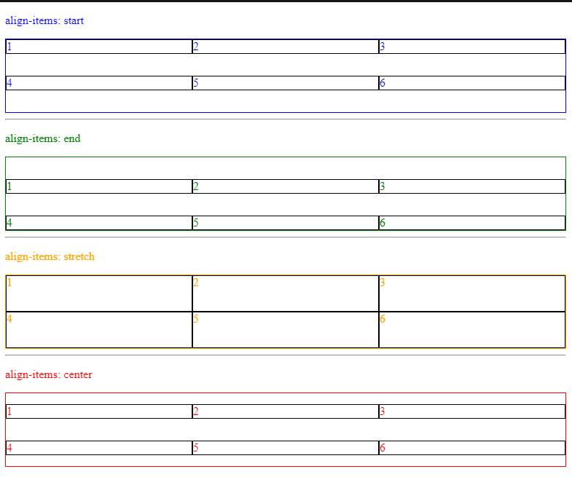
align-items
align-items property aligns grid items vertically within their grid cell.
.container1 {
display: grid;
grid-template-rows: 50px 50px;
grid-template-columns: repeat(3, 1fr);
align-items: start;
border: 1px solid blue;
color: blue;
}
.container1 {
display: grid;
grid-template-rows: 50px 50px;
grid-template-columns: repeat(3, 1fr);
align-items: end;
border: 1px solid blue;
color: blue;
}
.container1 {
display: grid;
grid-template-rows: 50px 50px;
grid-template-columns: repeat(3, 1fr);
align-items: stretch;
border: 1px solid blue;
color: blue;
}
.container1 {
display: grid;
grid-template-rows: 50px 50px;
grid-template-columns: repeat(3, 1fr);
align-items: center;
border: 1px solid blue;
color: blue;
}

Slide 18
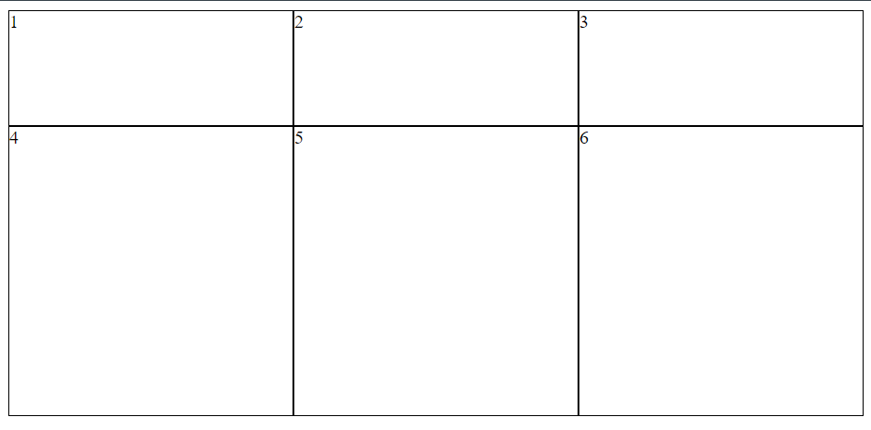
grid-auto-rows
grid-auto-rows property specifies the height of rows that are automatically created when there is no explicit row definition. grid-auto-rows property specifies the height of rows that are automatically created when there is no explicit row definition.
.container {
display: grid;
grid-template-columns: repeat(3, 1fr);
grid-template-rows: 100px;
grid-auto-rows: 250px;
}

Slide 19
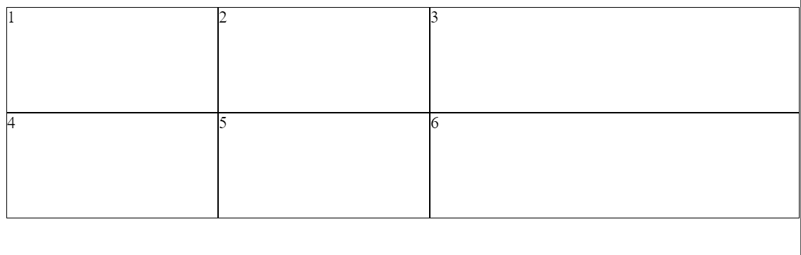
grid-auto-columns
grid-auto-columns property specifies the width of columns that are automatically created when there is no explicit column definition.
.container {
display: grid;
grid-template-areas: "name email phone";
grid-template-rows: 100px 100px;
grid-template-columns: 200px 200px;
grid-auto-columns: 350px;
}

Slide 20
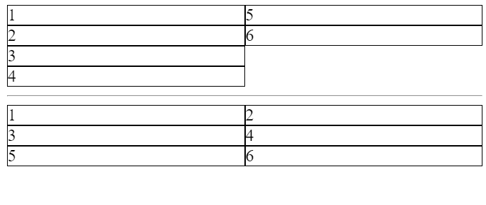
grid-auto-flow
grid-auto-flow property controls the placement of grid items when they do not fit into the explicit grid.
.container1 {
display: grid;
grid-template: repeat(4, 1fr) / repeat(2, 1fr);
grid-auto-flow: column;
}
.container2 {
display: grid;
grid-template: repeat(4, 1fr) / repeat(2, 1fr);
grid-auto-flow: row;
}

Slide 21
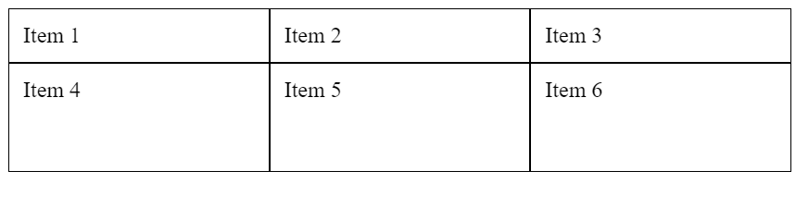
grid
grid is the shorthand property can be used to set a combination of grid properties, such as grid-template-rows, grid-template-columns, and grid-gap.
.container {
display: grid;
grid: 1fr 2fr / repeat(3, 1fr);
}

Slide 22
THANK YOU

